Slide 1
99A – E14th St
Hayward BART
Foothill Sq
Frequent
Peak Headway | Base Headway | Span
15 | 15 | 5:00 am
 |  | 12:00 am
99A
Foothill Sq
Downtown San Leandro
Bayfair Mall
Downtown Hayward
Bayfair BART
Hayward BART
97 Bayfair BART to Union City BART
60 Chabot College to Cal State East Bay
99A
North/East Route: From Hayward BART, Montgomery, R A St, L Mission, E 14th, L 159th., R Coelho into Bayfair BART. Coelho, L 159th, L E14th, R Dutton, L Macarthur, R 106th, R Foothill
South/West Route: From Foothill, R 106th, L Macarthur, R Dutton, L E 14th, R 159th, Coelho, Bayfair BART, Coelho, L 159th, R E 14th, into Mission, R B St R Hayward BART

Slide 2
99B – Mission Blvd
Hayward BART
Union City BART
Local
Peak Headway | Base Headway | Span
20 | 20 | 5:00 am
 |  | 12:00 am
99B
Downtown Hayward
Mission Corridor
South Hayward BART
Hayward BART
Union City BART
99B
99A Hayward BART E14th to Foothill Sq
60 Chabot College to Cal State East Bay
North/East Route: From Union City BART, R Union Sq, R Decoto, L Mission, L Tennyson, L Dixon, into South Hayward BART, Dixon, R Tennyson, L Mission., L Fletcher, R Watkins, L B St into Hayward BART
South/West Route: From Hayward BART, L C St, R Mission, R Tennyson, L Dixon, into South Hayward BART, Dixon, R Tennyson, L Mission, R Decoto, L Union Sq into Union City BART

Slide 3
97 – Hesperian
Bayfair BART
Union City BART
Frequent
Peak Headway | Base Headway | Span
15 | 15 | 6:00 am
 |  | 12:00 am
97
Bayfair Mall
Chabot College
Union Landing
Bayfair BART
Union Landing
Union City BART
97
99A Hayward BART E14th to Foothill Sq
60 Chabot College to Cal State East Bay
North/East Route: From Bayfair BART. L Coelho, L Hesperian, R into Chabot college, R Hesperian, into Union City, L Alvarado, L Dyer, R Alvarado Niles, R into Union Landin, L Alvarado Niles, L Decot, R Union Sq into Union City BART
South/West Route: From Union City BART, L Decoto, R Alvarado Niles, R Union Landing, R Alavarado Niles, L Dyer, R Alvarado, R Union City, R Hesperian, L Chabot College, L Hesperian, R Coelho, R Bayfair BART

Slide 4
89 – Lewelling-Davis
Hayward BART
Foothill Sq
Local
Peak Headway | Base Headway | Span
30 | 30 | 6:00 am
 |  | 10:00 pm
Downtown San Leandro
Foothill Sq
Walmart
San Leandro Marina
Downtown Hayward
San Leandro BART
Hayward BART
Bus Rapid Transit
89
99A Hayward BART Mission Blvd to Union City
Bus Rapid Transit (future)
60 Chabot College to Cal State East Bay
97 Bayfair BART to Union City BART
North/East Route: From Hayward BART, L C st, L Watkins St, L B St, R Montgomery, L A St, L Filbert, R B St, Meekland, L Lewelling, R Wicks, L Farallon, R Doolittle, L Bermuda, R Aurora, L Fairway, R Monarch, R Marina, L Aurora, R Williams, L Westgate, R Davis, R San Leandro into San Leandro BART, L Juana, L Hays, R Davis, R E14th, L Estudillo, L Macarthur, R 106th, R Foothill.
South/West Route: From Foothill, R 108th, L Macarthur, R Estudillo, R E 14th, L Davis, L Hays, R Juana, R San Leandro, L into San Leandro BART, L San Leandro, L Davis, L Westgate, R Williams, L Aurora, R Marina, L Monarch, L Fairway, R Aurora, L Bermuda, R Doolittle, L Farallon, R Wicks, L Lewelling, R Meekland, L A St, R Montgomery into Hayward BART

Slide 5
75 – Meekland-Davis
Hayward BART
Foothill Sq
Local
Peak Headway | Base Headway | Span
30 | 30 | 6:00 am
 |  | 10:00 pm
Downtown San Leandro
Foothill Sq
Downtown Hayward
Walmart
Kaiser Hospital (San Leandro)
75
San Leandro BART
Hayward BART
Bus Rapid Transit
Hayward Amtrak
99A Hayward BART Mission Blvd to Union City
Bus Rapid Transit (future)
60 Chabot College to Cal State East Bay
97 Bayfair BART to Union City BART
North/East Route: From Hayward BART, L C St, R Watkins, R D St, R Myrtle, L MLK, into Meekland, L Lewelling, R Farnsworth, L Purdue, R Wiley, L Spruce, R Merced, R Fairway, L into Kaiser, R Merced, L Williams, R Westgate, R Davis, R San Leandro, R San Leandro BART, L San Leandro, R Davis, R E 14th, L Estudillo, L Macarthur, R 106th, R Foothill.
South/West Route: From Foothill, R 108th, L Macarthur, R Estudillo, L E 14th, L San Leandro, L into San Leandro BART, L San Leandro, L Davis, L Westgate, L Williams, R Merced, L into Kaiser, R Fairway, L Merced, L Spruce, R Wiley, L Purdue, R Farnsworth, L Lewelling, R Meekland, L MLK, Myrtle, L Winton, L D St, L Watkins, L B St, L into Hayward BART

Slide 6
32 – Castro Valley
Hayward BART
Bayfair BART
Local
Peak Headway | Base Headway | Span
30 | 30 | 6:00 am
 |  | 8:00 pm
Bayfair Mall
Downtown Hayward
Downtown Castro Valley
32
Bayfair BART
Hayward BART
Castro Valley BART
99A Hayward BART Mission Blvd to Union City
60 Chabot College to Cal State East Bay
97 Bayfair BART to Union City BART
North/East Route: From Hayward BART, L C St, L Foothill, R D St, R Center, L Heyer, R Madison, L Seven Hills, L Redwood, R into Castro Valley BART, L Redwood, L Castro Valley, R Foothill, L Fairmont, L Hesperian, L Coehlo into Bay Fair BART.
South/West Route: From Bay Fair BART, L Coehlo, R Hesperian, R Fairmont, R Foothill, into John , L Castro Valley, R Redwood, R Castro Valley BART, L Redwood, R Seven Hills, R Madison, L Heyer, R Center, R B st, L into Hayward BART

Slide 7
60 – Winton
Cal State East Bay
Chabot Colege
Frequent
Peak Headway | Base Headway | Span
15 | 15 | 6:00 am
 |  | 10:00 pm
60
Cal State East Bay
Downtown Hayward
Chabot College
Southland Mall
Hayward BART
99A Hayward BART Mission Blvd to Union City
97 Bayfair BART to Union City BART
North/East Route: From Chabot College , L Hesperian, R W Winton, L D st, L Watkins, L B St, L into Hayward BART, L C St, R 2nd St, R Campus , R Hayward, L Carlos Bee, L E Loop, R Old Hilary, R Harder, R W Loop, CSEB.
South/West Route: From W Loop, L Carlos Bee, R Hayward, L 2nd St, L B St, L into Hayward BART, R Watkins, R D St, Into Winton St, L Hesperian, R Chabot College.

Slide 8
86–Tennyson/Winton
Hayward BART
South Hayward BART
Local
Peak Headway | Base Headway | Span
30 | 30 | 4:00 am
 |  | 12:00 am
Downtown Hayward
City Hall
Southland Mall
Hayward Industrial Area
Kaiser Hospital (Hayward)
Tennyson Center
Oliver Corners
86
Hayward BART
South Hayward BART
97 Bayfair BART to Union City BART
99A Hayward BART Mission Blvd to Union City
North/East Route: From South Hayward BART, L Dixon , L Tennyson, R industrial, L Depot, R Cabot, R Winton, L Mack, L Sabre, R Stearman, R Corsair, L Winton, into D St, L Grand, R B St, R Montgomery, R BART roadway into Hayward BART Station
South/West Route: From Hayward BART, via BART roadway into C St, R Watkins , R D St, into Winton, R Corsair , L Stearman, L Sabre, R Mack , R Winton , L Cabot, L Depot , R Industrial, L Tennyson, R Dixon , R BART Roadway into South Hayward BART

Slide 9
85–Jackson/Dyer
Hayward BART
Union Landing
Local
Peak Headway | Base Headway | Span
30 | 30 | 6:00 am
 |  | 8:00 pm
Downtown Hayward
City Hall
Jackson Square
Weekes Community Park
Tennyson Center
Hay./Huntwood Business Parks
Target (Whipple)
Union Landing
Hayward BART
Union Landing Transit Center
97 Bayfair BART to Union City BART
99A Hayward BART Mission Blvd to Union City
North/East Route: From Union Landing TC, L Union Landing roadway, R Alvarado Niles, R Dyer, into Whipple, L Huntwood, L Industrial, R Russ, L W Tennyson, R Tampa, R Patrick, into Gading, L W Harder, R Cypress, R W Jackson, L Watkins, L B St, R BART roadway into Hayward BART Station
South/West Route: From Hayward BART, via BART roadway into C St, R Watkins , R W Jackson, L Cypress, L W Harder, R Gading, into Patrick, L W Tennyson, R Ruus, L Industrial, R Huntwood, L Whipple, into Dyer, L Alvarado-Niles, L Union Landing roadway, R Union Landing Transit Center

Slide 10
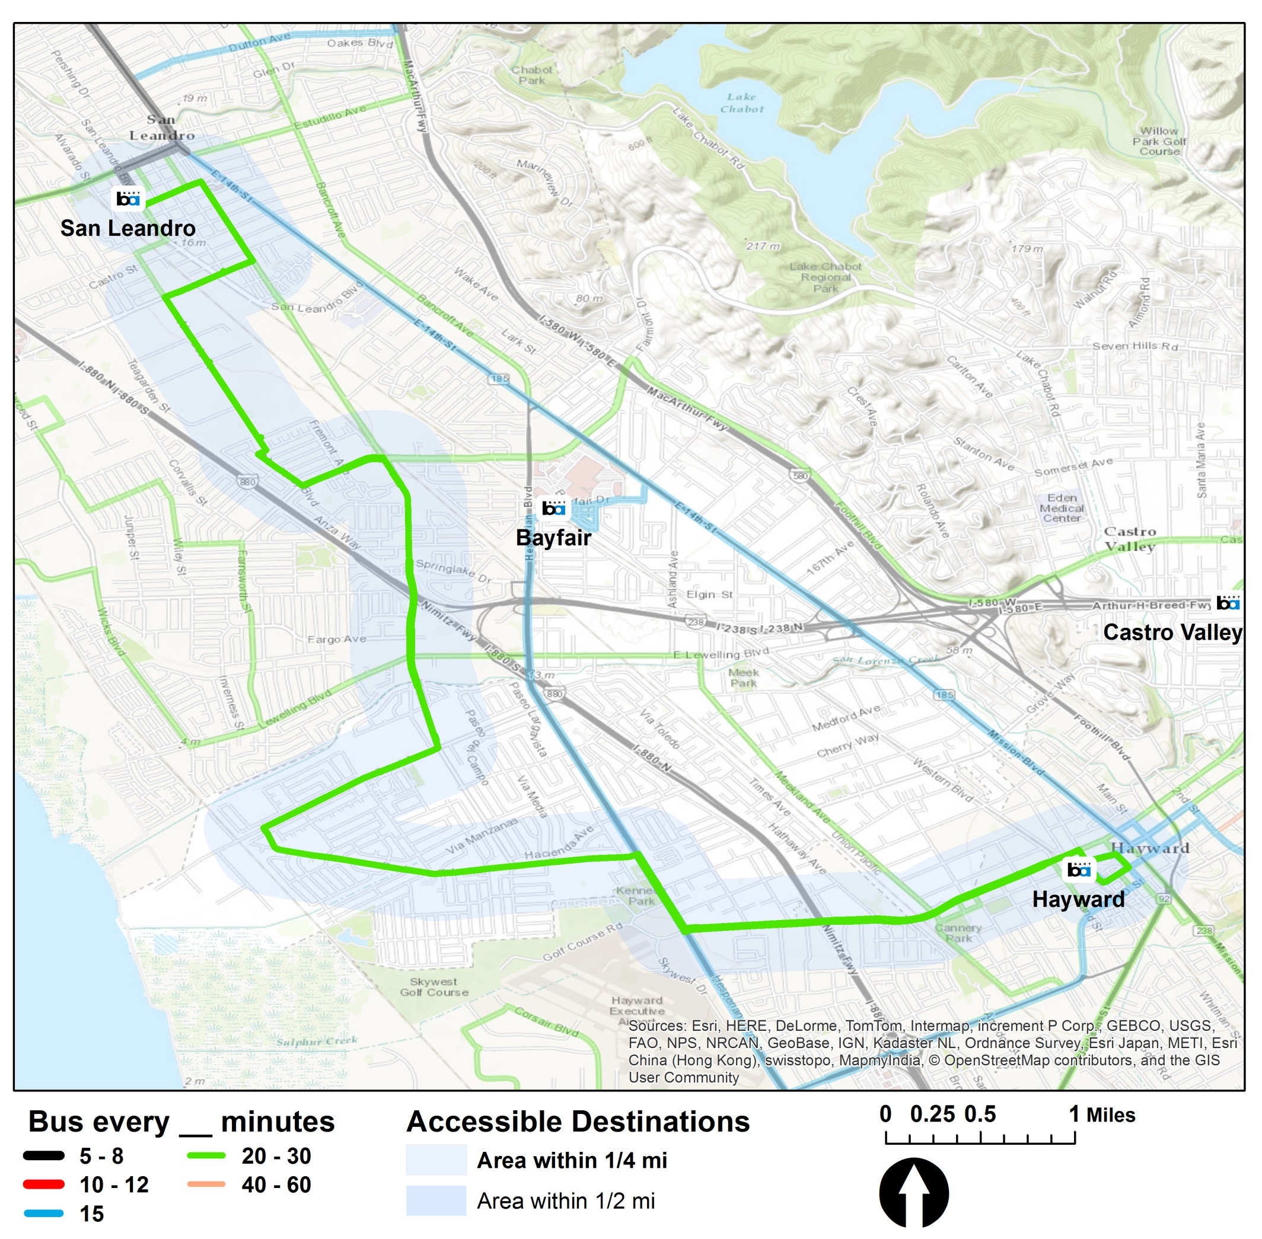
93–Washing./A St
San Leandro BART
Hayward BART
Local
Peak Headway | Base Headway | Span
30 | 30 | 6:00 am
 |  | 8:00 pm
Downtown San Leandro
Greenhouse Marketplace
Arroyo High School
Target (Hayward)
Downtown Hayward
San Leandro BART
Hayward BART
BRT (Future)
97 Bayfair BART to Union City BART
99A Hayward BART Mission Blvd to Union City
North/East Route: From Hayward BART, L C St, L Watkins, L B St, R Montgomery, L A St, R Hesperian, L Bockman, R Grant, L Washington, R Floresta,R Alvarado, L Marina, L Washington, L Juana, R San Leandro, L into BART roadway to San Leandro BART
South/West Route: From San Leandro BART, into West Juana, R Washington, R Marina L Alvarado, L Floresta, R Washington, R Grant, L Bockman, R Hesperian, L W. A St, R Montgomery, L B St, R roadway into Hayward BART

