Slide 1
Transbay Taskforce
Alameda – Contra Costa Transit District
July 28, 2020

Slide 2
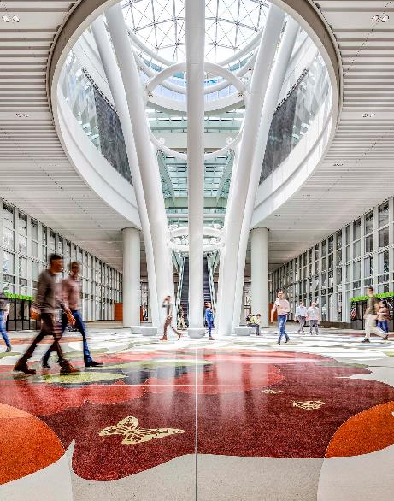
Agenda
Welcome
Pandemic: Impacts & Response
  Service
  Financial
Service Recovery Framework
Transbay Service Changes: August 9
Questions?
Notes:
AC Transit is owned by the people of the East Bay
Governed by a seven-member, publicly elected board of directors.
The Board consists Five Ward Directors and two At-Large Directors
We serve Alameda and Contra Costa Counties, from San Pablo all the way down to South Fremont.

Slide 3
Pandemic:
Impacts and Response
- Service

Slide 4
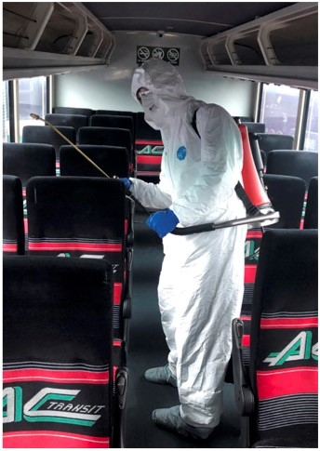
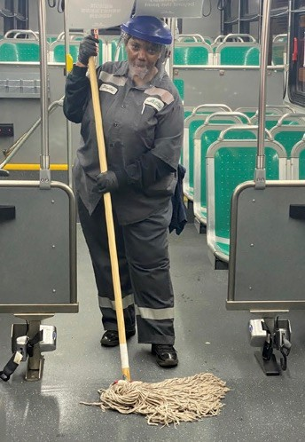
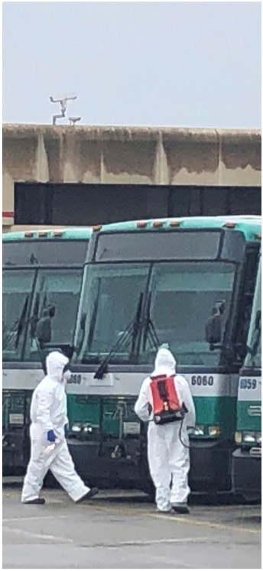
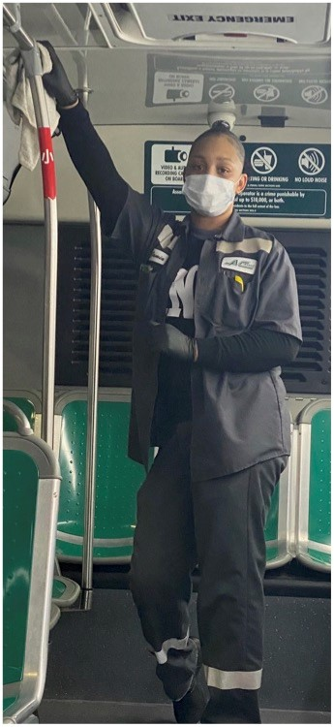
COVID-19 Pandemic Impacts to AC Transit
  Steady decline in ridership since March 8th. Currently at 34% of pre-COVID ridership
  Estimated loss of $5M a month of farebox revenue
  Significant loss of sales tax revenue, with projected sustained reduction in sales tax
  Temporary suspended our FLEX service and supplementary (school) service and peak-hour Transbay service

Slide 6
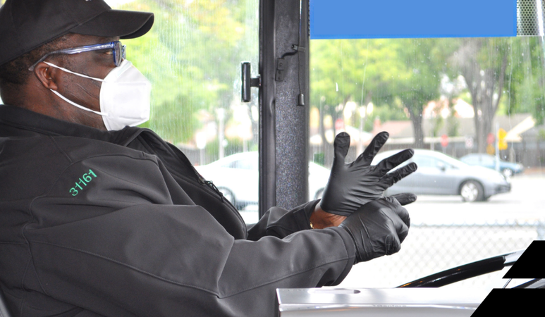
COVID-19 Pandemic Service Focus
Shelter in Place orders affected ridership on all routes, although not evenly – Initial 74% drop in ridership but a 96% drop in Transbay ridership
Implemented modified service schedules similar to Sunday service.
Focused on serving local riders who need to make essential trips and are transit dependent
Maintained trunk route frequency, All-Nighter service, most Early Bird Express routes, and service through disadvantaged communities

Slide 7
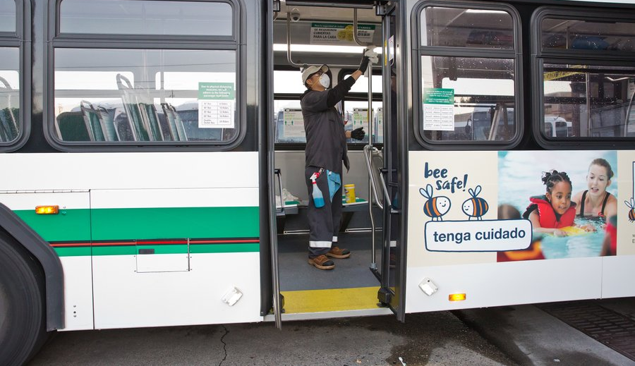
AC Transit COVID-19 Pandemic Response
Enhanced all sanitizing procedures:
  Sanitizing all coaches at the close of daily service – including driver compartments, fare boxes, Clipper card readers, handrails, stanchions, seats, and other onboard hard surfaces
  Daily fogging to disinfect vehicles
  Daily sanitization of AC Transit facilities Supply Personal Protective Equipment (PPE), for use of personnel, including gloves and masks.
  Supply hand sanitizer dispensers and individual use bottles at all AC Transit facilities
Employee Education and Awareness outreach
AC Transit has spent approximately $2.5 million for disinfection equipment, increased bandwidth and teleconferencing services

Slide 8
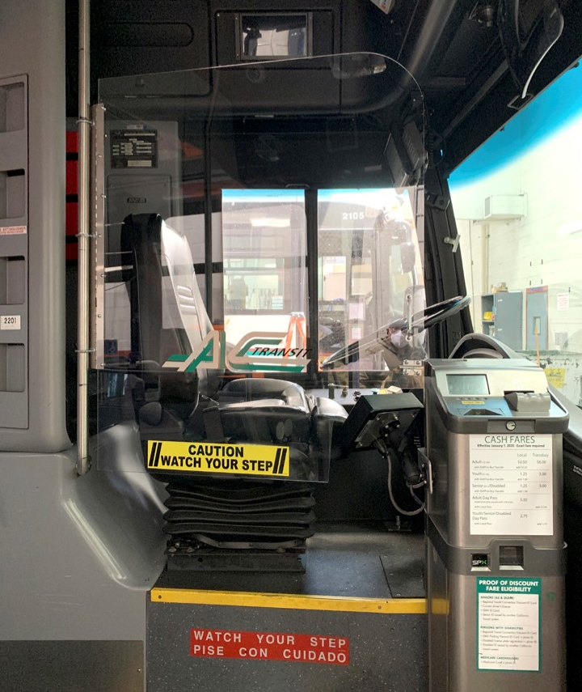
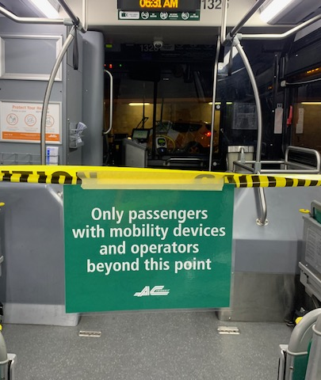
AC Transit COVID-19 Pandemic Response
In late March, instituted rear-door boarding and fare-free policy to protect our drivers and riders.​
In mid-April instituted seating limits on our service to further accommodate physical distancing onboard (approximately 20-25% of capacity)​
Installation of temporary plexiglass barriers for operator protection will be completed in fall

Slide 9
Pandemic:
Impacts and Response
- Financial

Slide 10
Measures Taken to Control Expenses
Service reduced to approximately 65% of pre-pandemic levels
Hiring freeze except for essential positions
Travel and training only for essential purposes
Evaluating new and renewal contracts for necessity
Notes:
Operators not working 6-7 days a week to make pullout

Slide 11
CARES Act Funding
District allocated $80M in first round and $33.8M in the second round
Staff estimates $30-40M of CARES Act funding will be needed to backfill losses in FY19-20
Notes:
We will likely draw down all of the CARES funds by December, but that with our other revenues should allow us to make it through the end of the FY in June 2021.
The real problem is next FY22, when we don’t have any CARES funds, and regular revenues are not back to 100%. Finance projections show us with a $30-40M hole and revenues not returning to pre-pandemic levels until near end of FY22-23.

Slide 12
Revenues
Revenue Overview
FY19-20 Revenue Overview
FY20-21 Draft Revenue Overview

Slide 13
Going Forward
Reserves currently untouched
Staff estimates District will utilize all CARES Act funds by end of calendar year 2020
Major cost driver is headcount
  Assuming reductions only by attrition
  CARES Act congressional expectation - funding is to keep employees on payroll
AC Transit can adjust with FY20-21 budget adoption as more is known

Slide 14
Service Recovery Framework

Slide 15

Uncertain Factors Impacting Recovery
Physical distancing on buses
Re-opening of schools
Commuter ridership demand
Traffic conditions
Long lead time to implement service changes

Slide 16
Service Recovery Phases
Actions-To-Date
3/16/20 - Suspended Supplementary School Service
3/31/20 – Implemented the Emergency Service Plan (equivalent to Sunday service levels)
Canceled the June Operator Sign-up with ATU due to safety concerns
Phase 1 – June 2020
Operate more Stand-by service:
Overloaded Trunk Lines
Nighttime Transbay Lines
Phase 2 – August 2020
Return service to 70-80% of pre-pandemic levels
Operate BRT at 10-minute frequency
Reactivate all Supplementary School Service as appropriate
Increase most trunk lines to weekday service levels
Limited Transbay service
Phase 3 – Summer 2021
Revamp service network to meet demand
Maintain 70-80% service levels or adjust based on available revenues
Conduct Public Hearing to implement new network

Slide 17

Blue Ribbon Transit Recovery Task Force –
Transit Agency Working Group Effort
Regular meeting and coordination amongst transit agencies
Provide collective input from the transit agencies to the Blue Ribbon Task Force regarding:
Finance
Health & Safety
Planning & Operations
Communications & Advocacy
Peer planning discussions, including level of service to be restored and when, vehicle load factors, ridership levels, and fare collection status/plans
Coordinating approaches to ramping up service up as economy re-opens and seeking opportunities for collaboration
Develop common set of standards for service operations such as Physical Distancing measures on buses and trains
Coordinated advocacy on financial and legislative actions and policy

Slide 18
Transbay Service Changes August 9, 2020

Slide 19





Rationale for Transbay Service Restoration
Passenger data immediately before shutdown
School service and Transbay efficiencies
Equity considerations
Budgetary constraints
Continued working from home

Slide 20
August Service Changes
Line NL: restored to previous weekday service
Line O: increased to every 30 minutes
Morning and evening service:
  Line J: 7:07am, 8:07am, 5:20pm, 6:20pm
  Line L: 6:48am, 7:42am, 5:15pm, 6:15pm
  Line LA: 6:37am, 7:34am, 5:25pm, 6:15pm
  Line W: 6:55am, 7:45am, 4:30pm, 5:30pm
Afternoon service only:
  Line G: 4:40pm, 5:40pm
  Line P: 4:45pm and 5:45pm
  Line NX1: 4:45pm, 5:45pm
  Line NX2: 4:45pm, 5:45pm
  Line V: 4:45pm, 5:45pm
Morning service only:
  Line NX: 7:30am, 7:50am

Slide 21
Q & A planning@actransit.org

Slide 22

We’ll get you there!
Connecting our Communities with safe,
reliable, sustainable service…
Notes:
Thank you for your time.
With that, I’d be happy to answer any questions.

