Slide 1
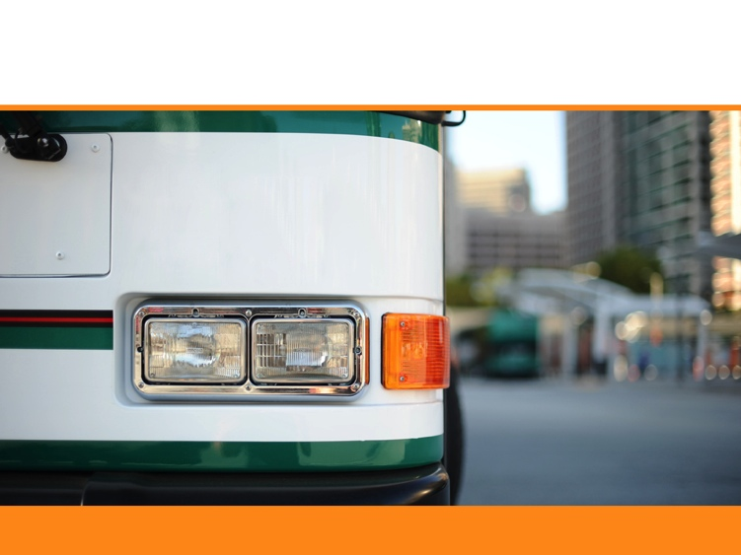

Transbay Taskforce
WELCOME!
AC Transit • 1600 Franklin Street • Oakland, CA 94612 • actransit.org

Slide 2
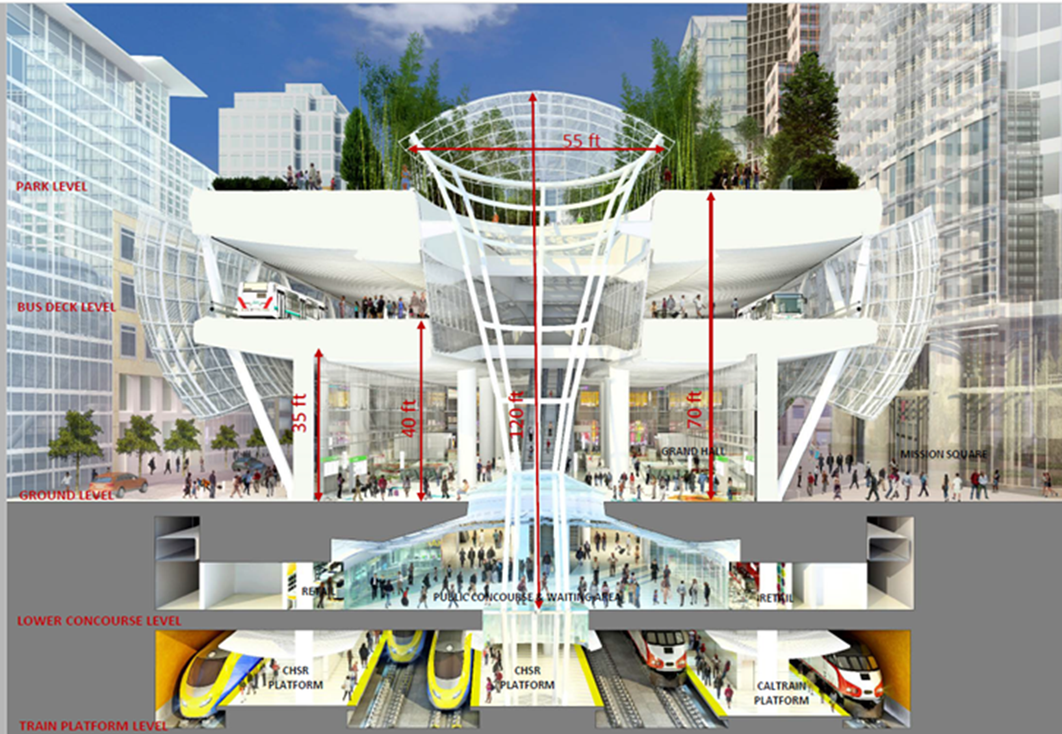

Salesforce Transit Center
actransit.org

Slide 3
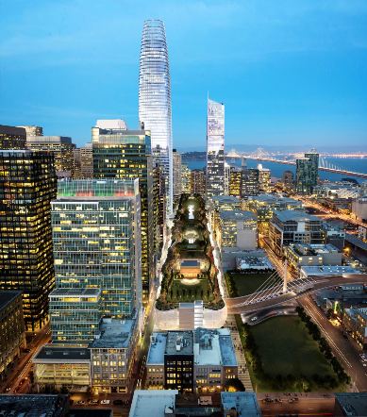
Salesforce Transit Center
Full Operations August 12th, 2018
Dedicated Bays for each Route
Dedicated Off-Ramp from Bay Bridge
  No more San Francisco Streets
Capacity to Grow Service
More Passenger Amenities
  Weatherproof
  Retail
Reduced Emissions and Increased PM Reliability with Midday Storage

Slide 4
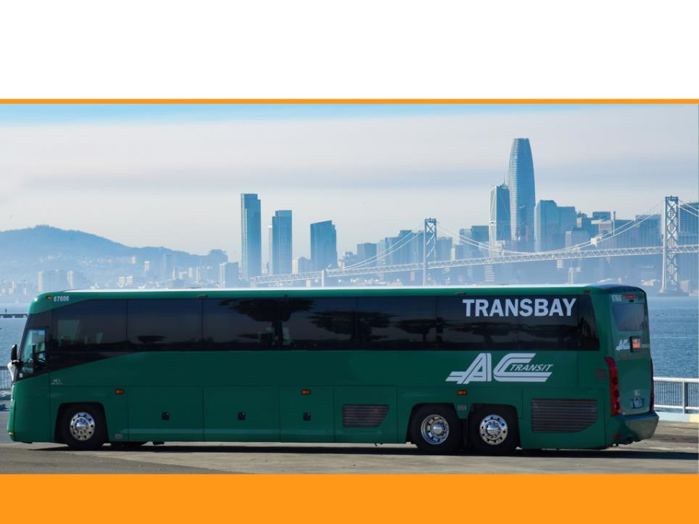
Transbay Tomorrow
actransit.org

Slide 5
Transbay Tomorrow: Overview
Launched from MTC’s Core
Capacity Transit Study
To develop and Implement Bay Bridge Transbay Service Improvements across:
  Routing
  Scheduling
  Stops
  Fares
  Infrastructure
Three Phases:
  Existing Conditions (complete)
  Cost-Neutral Service Plan & Fare Policy (ongoing)
  Expansion Service Plan (2018-2019)
Notes:
Transbay expansion possible ONLY if RM3 passes, or an additional funding source is found

Slide 6
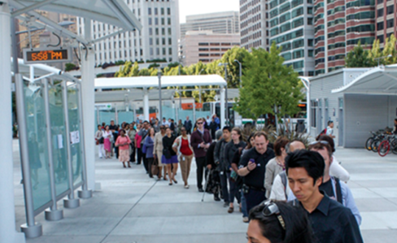
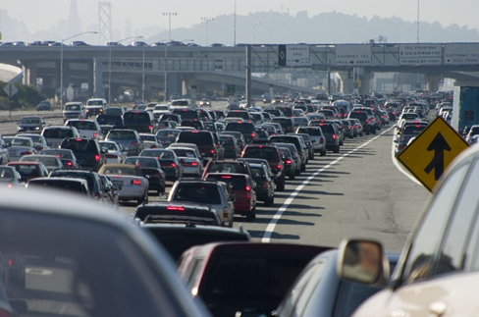
Major Issues
Overcrowding
Speed
Reliability
Productivity

Slide 7
Transbay Average Daily Ridership
Ridership has increased 30% in the last 5 years
Notes:
Ridership has grown 30% over the last 5 years
Note the severe decline in ridership as a result of the “Great Recession “

Slide 8
Transbay Average Speed
Notes:
Average decrease of 2 MPH
Service has become increasingly more expensive

Slide 9
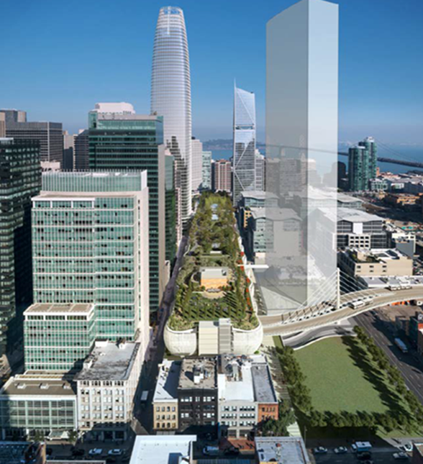
Improving Reliability & Speed
Truncate Routes
Reconfigure Routes
Bus Stop Consolidations
Prioritize Transbay Riders
Prioritize Buses
  Traffic Signal Technology
  Dedicated Bus Lanes
  Bus On/Off-Ramps
Notes:
Guiding Principles
Meet the existing and future demand
Improve speed, reliability and efficiency
Transbay service should sustain itself
Think regionally

Slide 10
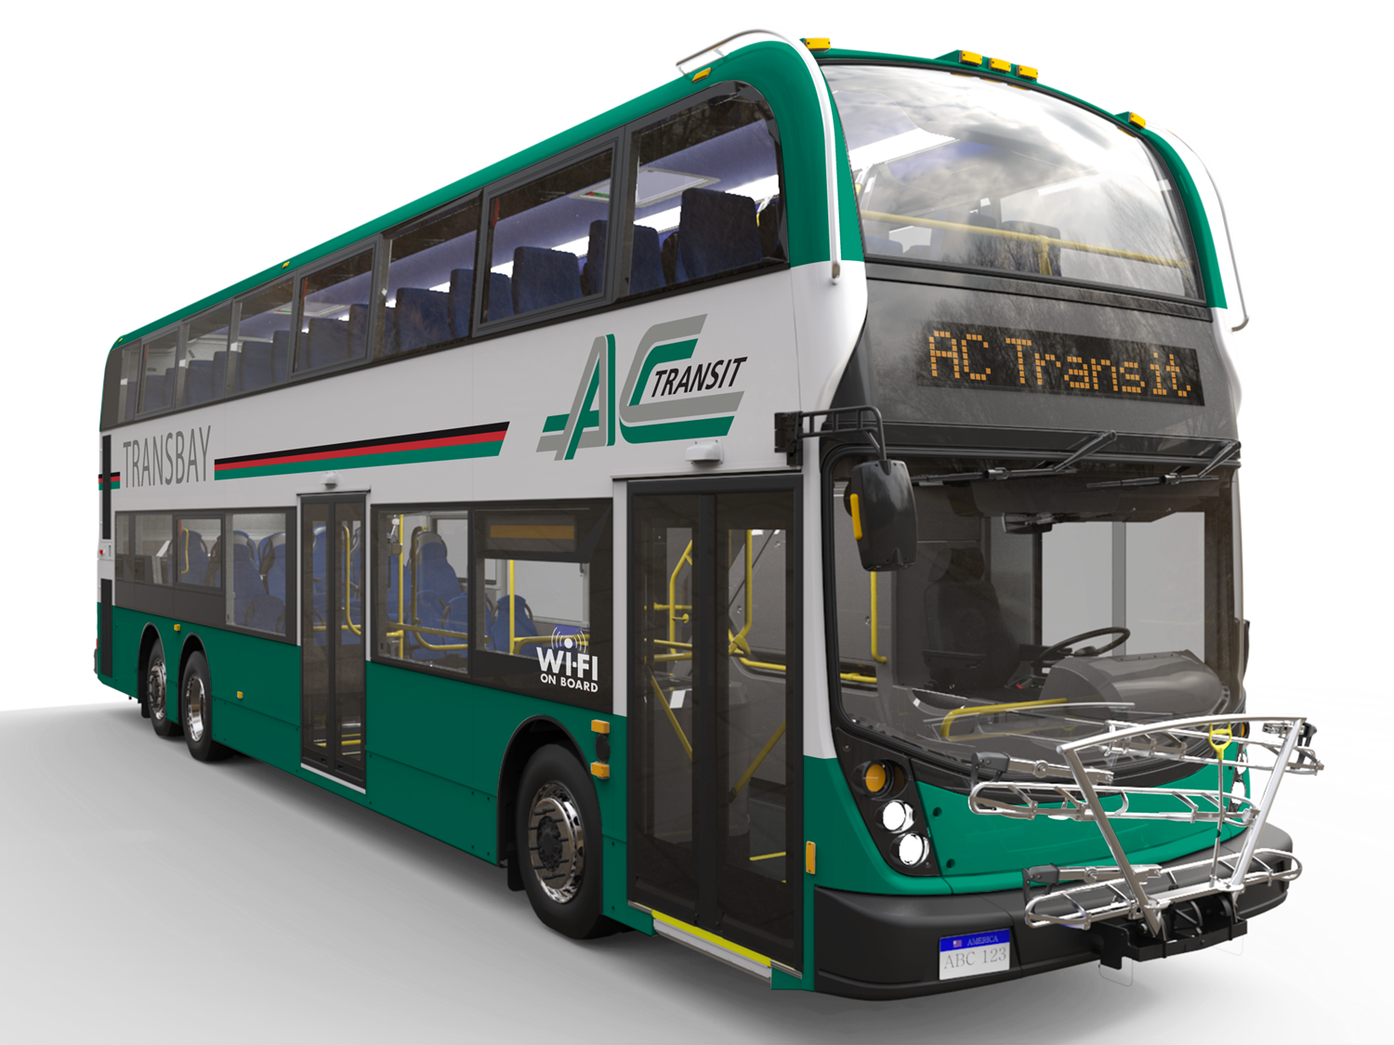
Reducing Overcrowding & Improving Productivity
Cut Unproductive Service and Reallocate Resources
Reconfigure Routes
Frequency Increases
Span Increases
Double Decker Buses
Notes:
Fill up buses with capacity
Mention that we piloted a double decker bus and offered free rides

Slide 11
Line F
UC Campus to Transbay Terminal, SF
via Shattuck Avenue / Adeline Street / 40th Street
Notes:
Staff is recommending a number of changes to our Transbay service based on data analysis and extensive community input.
This is an example of changes that are being proposed in the northern end of our service area.
Increase frequency during peak hours – from 30 to 15 minutes

Slide 12
Next Steps
August – Part I Implementation
December – Part II Implementation
2018-19 – Develop Expansion Plan for 2020
Notes:
Two Public Hearings:
Wednesday, March 28, 12 p.m. at Golden Gate University in San Francisco
Wednesday, March 28, 6 p.m. at AC Transit General Offices in Oakland
The Board of Directors has final say on staff’s proposal.
April 25: Final determination on Transbay Tomorrow proposal

Slide 13
August Service Change
actransit.org

Slide 14
August Service Change
Part I – Transbay Tomorrow
Speed Service with Stop Adjustments
Restrict Local Passengers
Line L Route Adjustment
Line S Route Adjustment
Line E Schedule Adjustment
Notes:
Fill up buses with capacity
Mention that we piloted a double decker bus and offered free rides

Slide 15
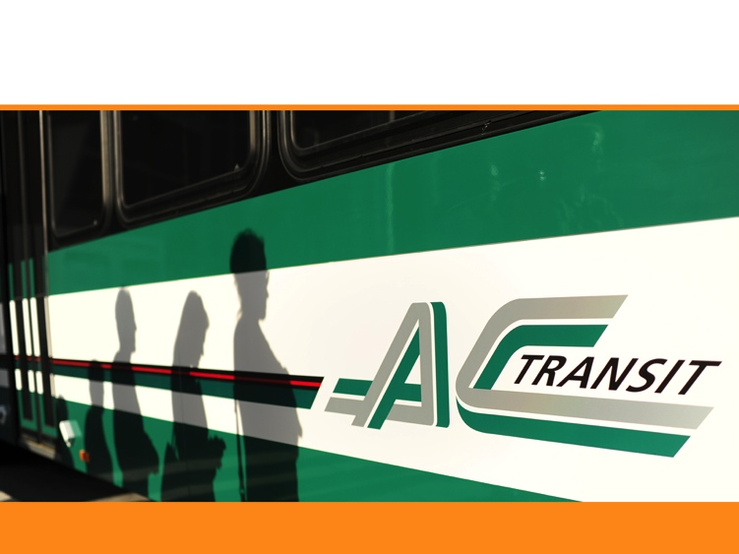
RM 3 and SB 1

Slide 16
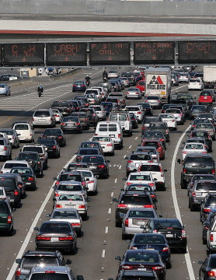
Regional Measure 3
Toll increase on 7 state-owned bridges phased in over 6 years
Passed with 54% support
$1 – January 1, 2019
$1 – January 1, 2022
$1 – January 1, 2025
4.5 Billion Expenditure Plan
35 capital projects
16% transit operating program
Notes:
Regional Measure 3 (RM 3), authorized by SB 595 (Beall), allows for a toll increase of up to $3 to be placed on the ballot in all nine Bay Area counties.
SB 595 contains a $4.5 billion expenditure plan funding 35 capital projects and a 16% transit operating program for ferries, express bus and the Transbay Terminal.
Following the multimodal approaches of RM 1 and RM 2 (1988 and 2004), it would fix highway bottlenecks, expand and extend BART, expand bus and ferry service, and improve bike and pedestrian access to transit and the Bay Trail.

Slide 17
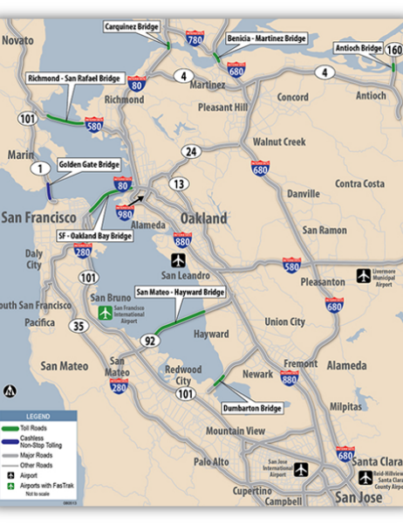
Benefits to AC Transit
Regional Express Bus
$20 million for “Regional Express Service”
Core Capacity Transit Improvements
$140 million for new buses, a new bus facility, and other enhancements to Transbay service.
Rapid Bus Improvements
$100 million for AC Transit Rapid Bus Improvements
Notes:
Note: we don’t get the full $20M for Regional Express Bus; we would receive an allocation that is in proportion to the services we provide across the Bay Bridge

Slide 18
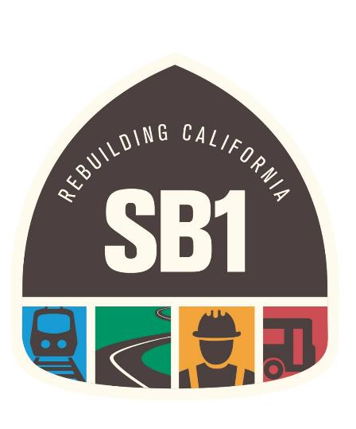
How can
SB1 help?
Invests $5.4 billion annually over the next decade to fix California’s transportation system
Addresses a backlog of repairs and upgrades, while ensuring a cleaner and more sustainable travel network for the future
Funds will be protected under a constitutional amendment (ACA 5) which safeguards new dollars for transportation use only

Slide 19
What does SB1 do?
AC Transit will use the funds to:
Replace 59 urban diesel buses with hybrid buses
Acquire 15 zero-emission buses
Renovate our Customer Service Center
Support General Operations
Funding for BRT Project
SB1 Revenue Mechanisms:
12¢ increase in gasoline excise tax
20¢ increase in diesel excise tax
4% increase in diesel sales tax
New annual vehicle registration fee based on market value, capped at $175
New Road Improvement Fee of $100 per zero emission vehicle

Slide 20
Vulnerability of SB1
SB 1 is facing a repeal effort – seeks a constitutional amendment that would repeal SB1 and require future increases to be approved by voters.
This effort will be on the November ballot as Proposition 6.
“Fighting the gas tax may appear to be good politics, but it isn’t. I will do everything in my power to defeat any repeal effort that may make it to the ballot.” – Governor Jerry Brown

Slide 21

Connecting our Communities with safe, reliable, sustainable service…
We’ll get you there!
AC Transit • 1600 Franklin Street • Oakland, CA 94612 • actransit.org
Notes:
Thank you for providing AC Transit with an opportunity to share this update with you. At this time we would be happy to answer any questions.

